Slide 1
Lecture 10:
Face Recognition
Most material from Andrew NG’s course at Coursera
Pooya Mohammadi Lecture 10 - 1 Winter-2020

Slide 2
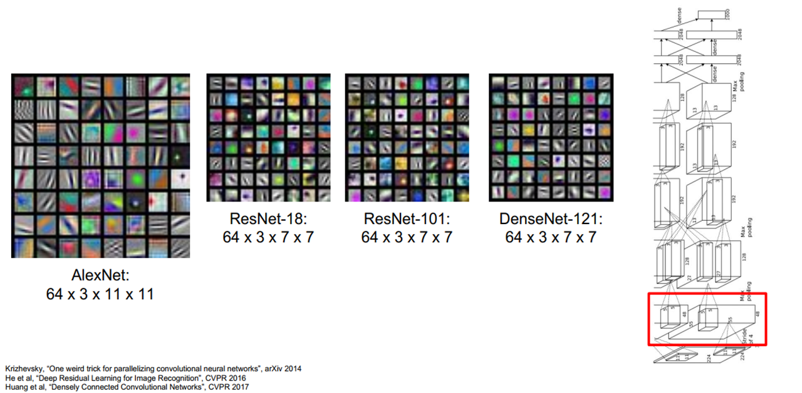
Last time: Visualization(First Layer)
Pooya Mohammadi Lecture 10 - 2 Winter-2020

Slide 3
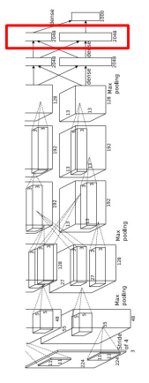
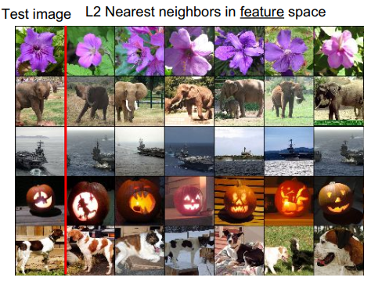
Last time: Visualization(Last Layer)
Pooya Mohammadi Lecture 10 - 3 Winter-2020

Slide 4
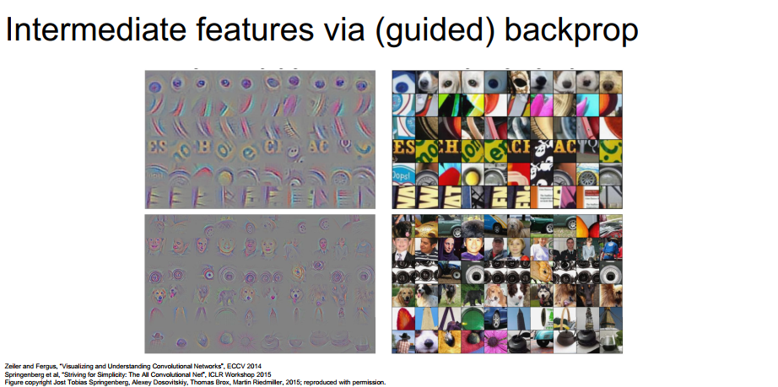
Last time: Visualization(Intermediate Features via backprop)
Zeiler and Fergus, “Visualizing and Understanding Convolutional Networks”, ECCV 2014
Springenberg et al, “Striving for Simplicity: The All aConvolutional Net”, ICLR Workshop 2015
Figure copyright Jost Tobias Springenberg, Alexey Dosovitskiy, Thomas Brox, Martin Riedmiller, 2015; reproduced with permission.
Pooya Mohammadi Lecture 10 - 4 Winter-2020

Slide 5
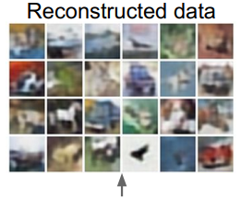
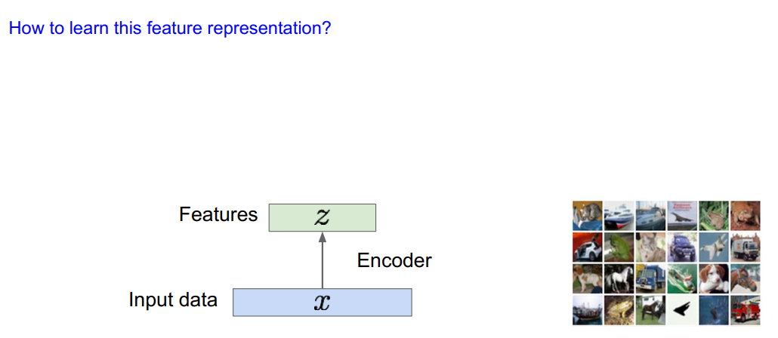
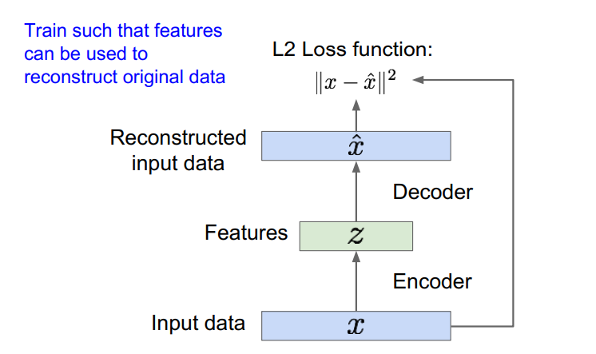

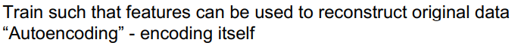
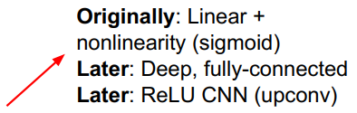
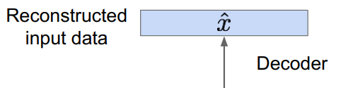
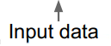
Last time: Auto-Encoder
Pooya Mohammadi Lecture 10 - 5 Winter-2020

Slide 6
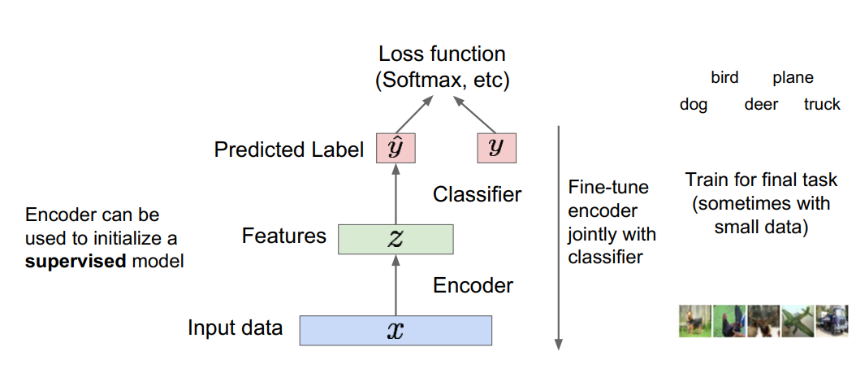
Last time: Auto-Encoder
Pooya Mohammadi Lecture 10 - 6 Winter-2020

Slide 7
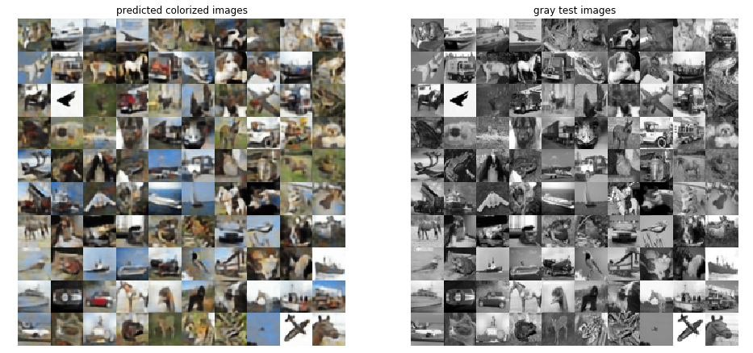
Last time: Auto-Encoder
Pooya Mohammadi Lecture 10 - 7 Winter-2020

Slide 8
Today:
Face Detection
Liveness Detection
Face Recognition
Face Verification
Face Identification
One-shot Learning
Siamese Network
Triplet Loss
Pooya Mohammadi Lecture 10 - 8 Winter-2020

Slide 9
Face Detection
Pooya Mohammadi Lecture 10 - 9 Winter-2020

Slide 10
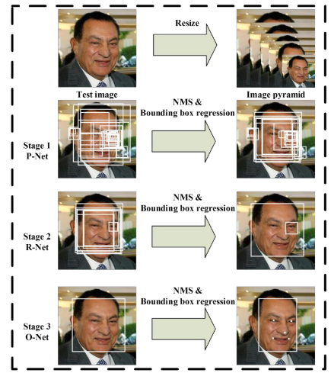
Face Detection:
[Zhang et al.,2015, Joint Face Detection and Alignment using Multi-task Cascaded Convolutional Networks]
Pooya Mohammadi Lecture 10 - 10 Winter-2020

Slide 11
Liveness Detection
Pooya Mohammadi Lecture 10 - 11 Winter-2020

Slide 12
Liveness Detection:
Pooya Mohammadi Lecture 10 - 12 Winter-2020

Slide 13
Face Recognition
Pooya Mohammadi Lecture 10 - 13 Winter-2020

Slide 14
Face Recognition:
Verification
Input image, name/ID
Output whether the input image is that of the claimed person
Recognition
Has a database of K persons
Get an input image
Output ID if the image is any of the K persons (or “not recognized”)
Pooya Mohammadi Lecture 10 - 14 Winter-2020

Slide 15
One-Shot Learning
Pooya Mohammadi Lecture 10 - 15 Winter-2020

Slide 16

One-shot Learning:
Learning from one example to recognize the person again
Solution: Soft-max
We don’t have enough training data
What if new person joins the team??
Pooya Mohammadi Lecture 10 - 16 Winter-2020

Slide 17


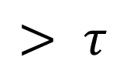
One-shot Learning: Similarity Function
d(img1,img2) $=$ degree of difference between images
If d(img1,img2) $≤ τ$
Same
$$> τ$$
Different
We need to learn d or Similarity function
Pooya Mohammadi Lecture 10 - 17 Winter-2020

Slide 18
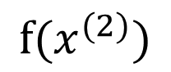
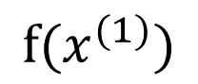
Siamese Network:
$$⋮$$
$$⋮$$
$$x^{(1)}$$
Encoding
$$f(x^{(1)})$$
$$⋮$$
$$⋮$$
$$x^{(2)}$$
$$f(x^{(2)})$$
[Taigman et. al., 2014. DeepFace closing the gap to human level performance]
Pooya Mohammadi Lecture 10 - 18 Winter-2020

Slide 19
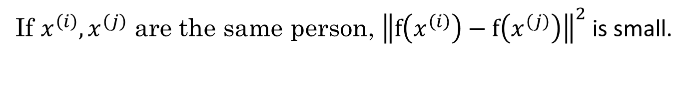
Siamese Network:
$$⋮$$
$$⋮$$
$$f(x^{(1)})$$
Parameters of NN define an encoding $f(x^{\left(i\right)})$
Learn parameters so that:
If $x^{\left(i\right)},x^{\left(j\right)}$ are the same person, ${\left\|f\left(x^{\left(i\right)}\right)−f\left(x^{\left(j\right)}\right)\right\|}^{2}$ is small.
Pooya Mohammadi Lecture 10 - 19 Winter-2020

Slide 20
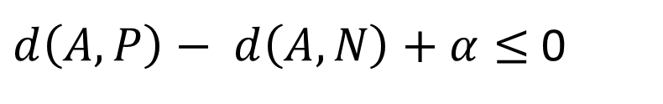
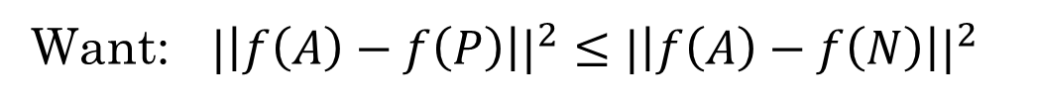
Triplet Loss:
Encodings to similar
Encodings to different
Anchor
Positive
Anchor
Negative
Want: ${|\left|f\left(A\right)−f\left(P\right)\right||}^{2}≤{|\left|f\left(A\right)−f\left(N\right)\right||}^{2}$
${|\left|f\left(A\right)−f\left(P\right)\right||}^{2} − {\left|\left|f\left(A\right)−f\left(N\right)\right|\right|}^{2} ≤$ 0
$d\left(A,P\right)− d\left(A,N\right)+α≤$ 0
[Schroff et al.,2015, FaceNet: A unified embedding for face recognition and clustering]
Pooya Mohammadi Lecture 10 - 20 Winter-2020

Slide 21
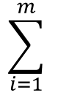
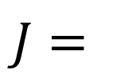
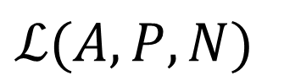
Triplet Loss:
Given 3 images A, P, N:
$$ℒ\left(A,P,N\right)=max⁡({\left|\left|f\left(A\right)−f\left(P\right)\right|\right|}^{2}≤{\left|\left|f\left(A\right)−f\left(N\right)\right|\right|}^{2}, 0)$$
$$J=$$
$$\sum_{i=1}^{m}{ }$$
$$ℒ(A,P,N)$$
Training set: 10k pictures of 1k persons
[Schroff et al.,2015, FaceNet: A unified embedding for face recognition and clustering]
Pooya Mohammadi Lecture 10 - 21 Winter-2020

Slide 22
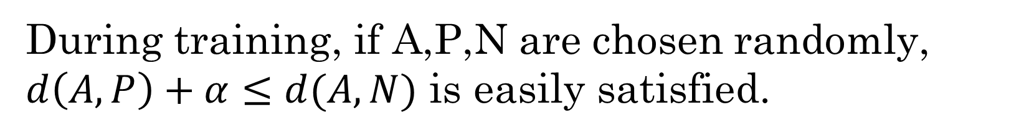
Triplet Loss: Choosing Samples
During training, if A,P,N are chosen randomly, $d\left(A,P\right)+α≤d(A,N)$ is easily satisfied.
Choose triplets that’re “hard” to train on.
[Schroff et al.,2015, FaceNet: A unified embedding for face recognition and clustering]
Pooya Mohammadi Lecture 10 - 22 Winter-2020

Slide 23
Triplet Loss: Summary
Anchor
Positive
Negative
Pooya Mohammadi Lecture 10 - 23 Winter-2020

Slide 24
Supervised Loss:
$$⋮$$
$$f(x^{(i)})$$
$$⋮$$
$$f(x^{(j)})$$
[Taigman et. al., 2014. DeepFace closing the gap to human level performance]
Pooya Mohammadi Lecture 10 - 24 Winter-2020

Slide 25
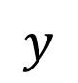
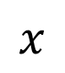
Supervised Loss:
$$x$$
$$y$$
$$1$$
$$0$$
$$0$$
$$1$$
[Taigman et. al., 2014. DeepFace closing the gap to human level performance]
Pooya Mohammadi Lecture 10 - 25 Winter-2020

Slide 26
What’s Next:
Pooya Mohammadi Lecture 10 - 26 Winter-2020

Slide 27
Question??
Pooya Mohammadi Lecture 9 - 27 Winter-2020

